Slide 1
Hospital Management System
GROUP10 Team members:
Anjali Sajeevan
Deepika Kumari Jha
Madhurima Chatterjee
Sayali Nitin Chaudhary
Shreya Uppalapati
Singh Pooja Kumari

Slide 2

Why Hospital Management System?
Automated and Seamless Management
Easier tracking of information
Eliminate probabilities of errors
COVID-19
Better decision making based on actual data

Slide 3
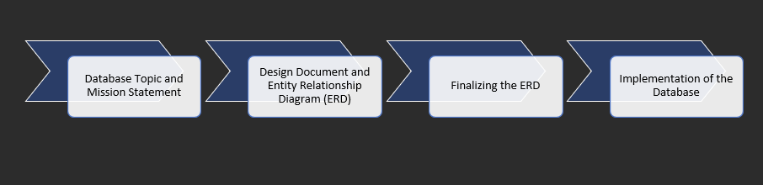
Phase Diagram

Slide 4
ENTITY RELATIONSHIP DIAGRAM

Slide 6
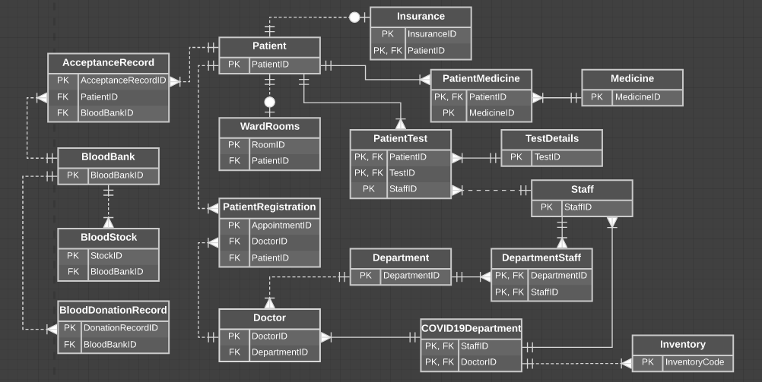
Notes:
Here we have the entity relationship diagram of our database, with about 18 entities. We have not listed all the columns of each entity, that would’ve occupied a lot of space. We have, however, enlisted the primary key and the foreign key to justify the relationship each entity has with the other. For example: we have a non-identifying relationship between Patient and WardRooms because a patient can be either an out-patient or an in-patient, which is when a room can be allocated to that patient.

Slide 7
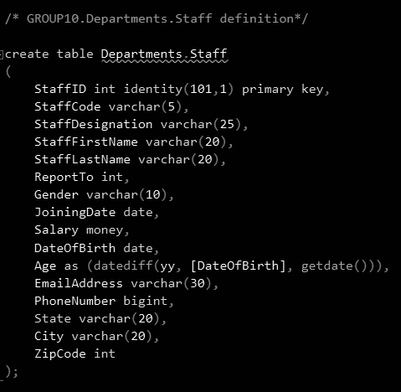
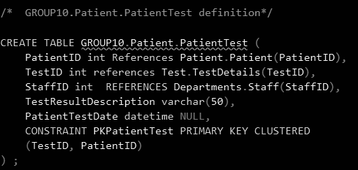
Data Implementation
Notes:
Here we have shown 2 examples of tables created. On the left we have the Staff Table columns. Now the age of a staff member will always be relative to the current year, hence we have kept Age as a computed column where we calculate the difference between the current year and the birth year. On the right we have an associative entity called PatientTest to avoid many to many relationship between Patient entity and Test entity. To keep the Patient-Test pair unique, we have set a constraint to store TestID and PateintID as a primary key pair/cluster.

Slide 8

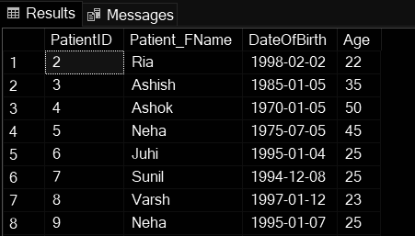
Data Implementation - Functions
Create function dbo.cal_PatientAge(@PatientID int)
returns int
as begin
declare @Age int =(select DATEDIFF(hour,DateOfBirth,GETDATE())/8766 from Patient.Patient
where patientID=@patientID);
SET @Age = ISNULL(@Age, 0);
RETURN @Age;
END

Slide 9

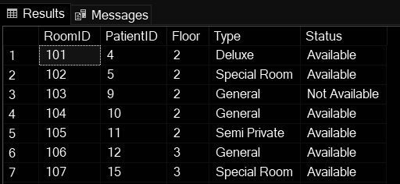
Data Implementation - Functions
Create function dbo.RoomAvailability(@PatientID int)
returns varchar(50)
As begin
declare @Sts varchar(50)= (select
case when exitdate is null then 'Not Available'
else 'Available'
end as [Status]
from Patient.Patient
where PatientID=@PatientID);
return @Sts;
end

Slide 10
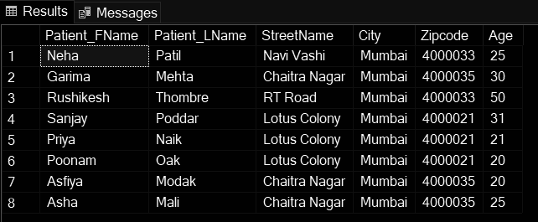
Data Implementation - View
Create view COVID.COVID_Patient as
select Patient_FName
Patient_LName,
StreetName,
City,
Zipcode,
Age
from Patient.Patient
where Diagnosis='COVID';

Slide 11
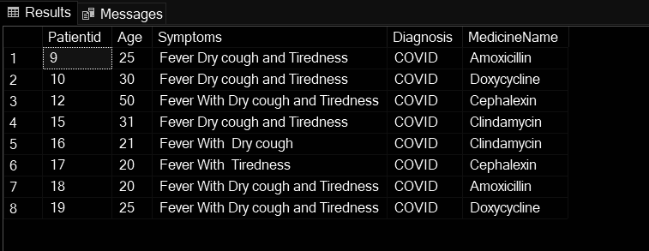
Data Implementation - View
Create view COVID.COVID_Analysis as
select p.Patientid, Age,
p.Symptoms,p.Diagnosis, MedicineName
from
patient.Patient p join
medicine.PatientMedicine pm
on p.patientid=pm.patientid
join medicine.Medicine m
on pm.MedicineID=m.MedicineID
where p.Diagnosis='COVID'

Slide 12
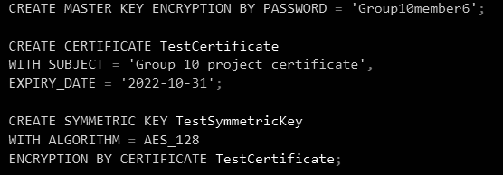
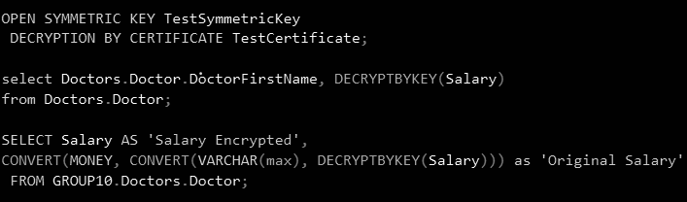
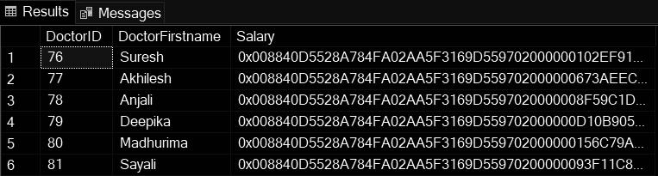
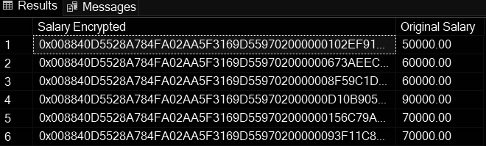
Encryption
Notes:
So lets talk about the encryption that we have done for our project.the salaries of doctors shoudnt be visible to everyone accessing the database. In the doctor’s entity, we have encrypted the salary column. As you can see in the first table the column salary is encrypted. The table on the right side shows the original values obtained after decrypting the salary column.

Slide 13
DATA VISUALIZATION

Slide 14
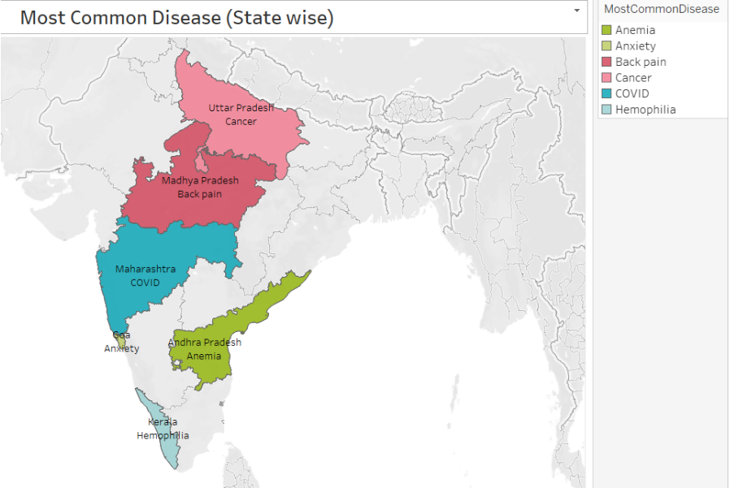
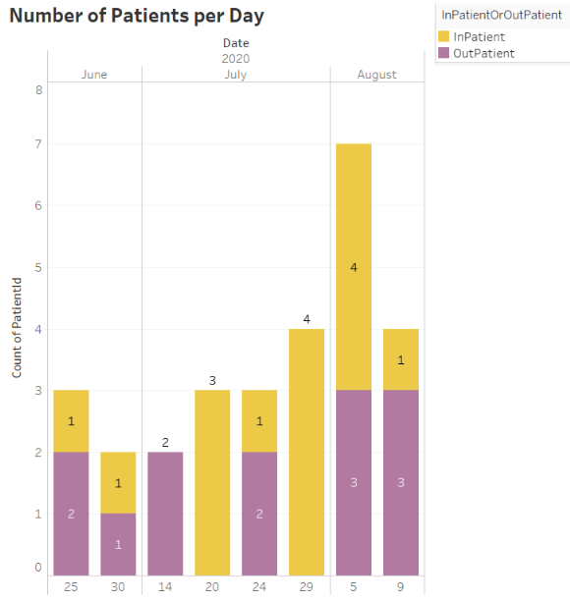
Data Analysis

Slide 15
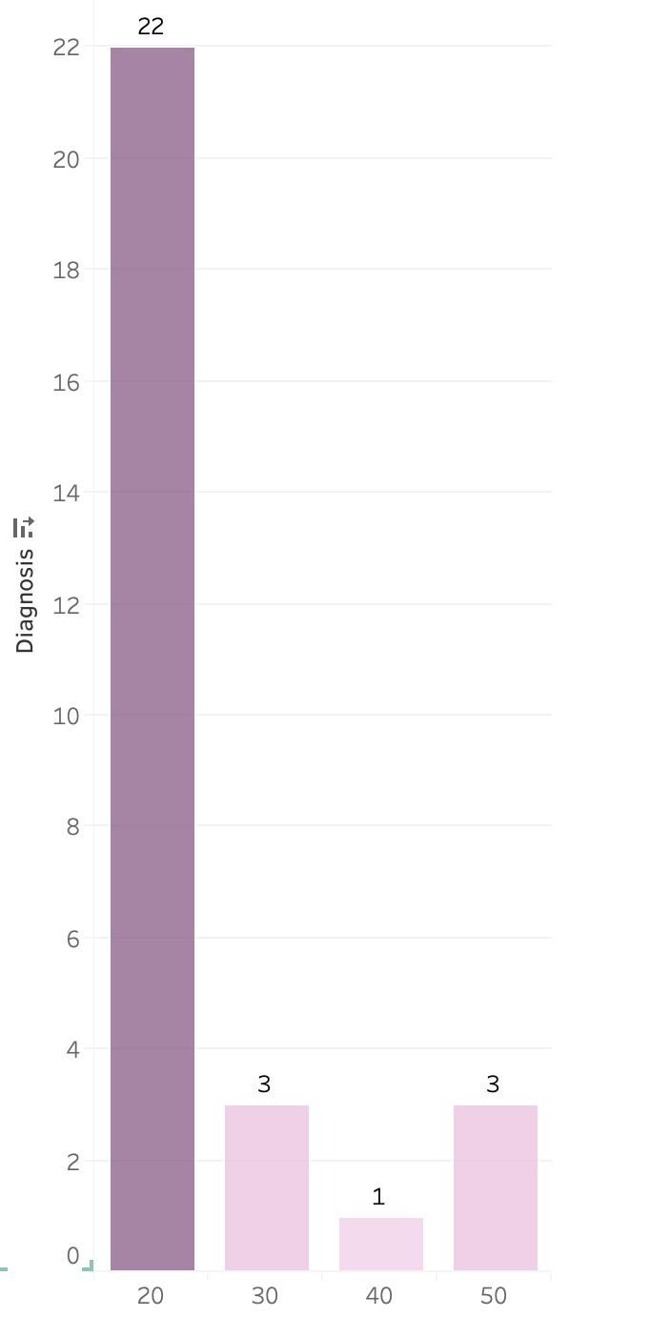
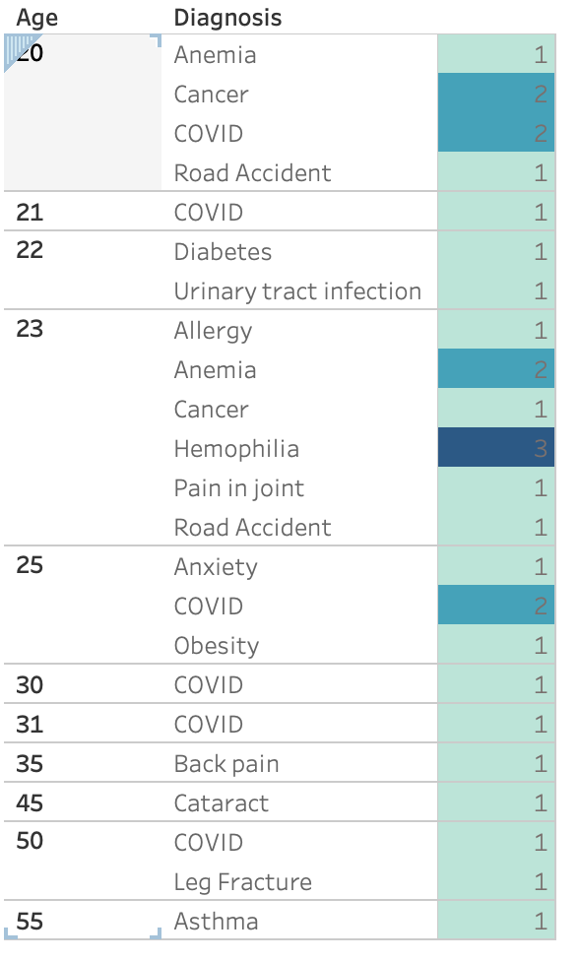
Notes:
Left graph gives the age range of the patients in the range(20-55)
Highest patients are those of the age group 20-30 where there are 22 patients while 40-50 age group has the least patients .
The right side gives a detailed view of the diagnosis for all the ages admitted to the hospital.

Slide 16
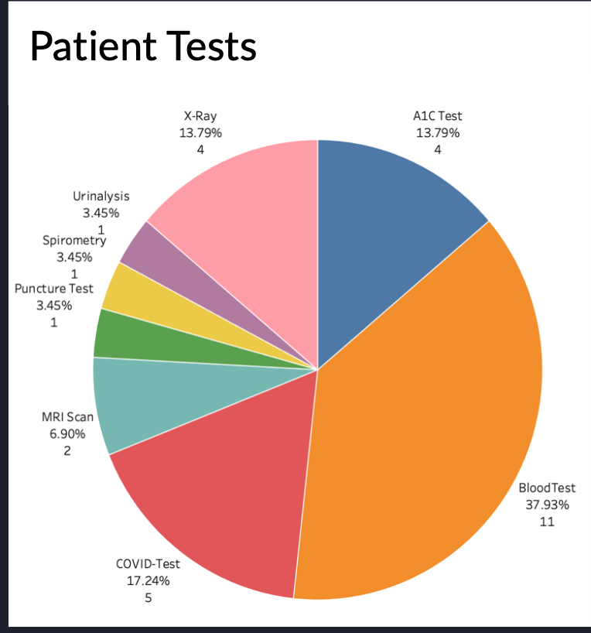
Notes:
We built a Pie chart which basically talks about the most common tests assigned to patients from the data
Blood Test is the most common followed by Covid,XRAY and A1c where a1c test is for diabetes.

Slide 17

Thank You!!

